Slide 1




1
Unveiling the Metaverse
A Journey into the Next
Frontier of Digital Reality
Technical Seminar
221FJ01071 - Suraj Kumar Singh

Slide 2
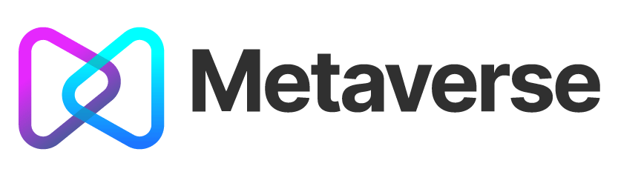
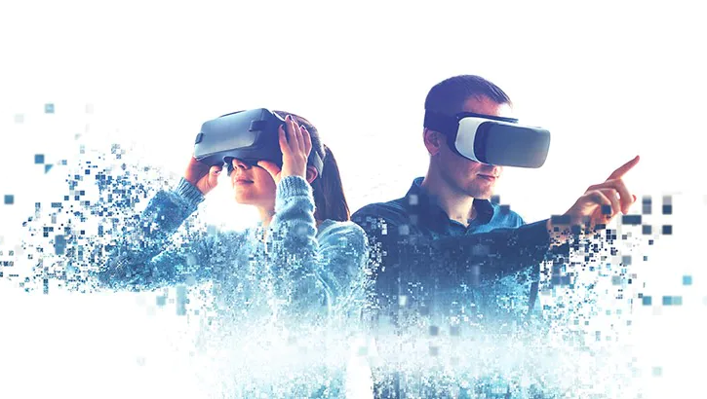
2
Introduction
The Metaverse is a digital universe where people interact, socialize, and engage in various activities through virtual and augmented reality technologies.
3D virtual reality and augmented reality in which users can enter a virtual world to work, shop, play, communication and socialize with the feeling of being present, though virtually.

Slide 3
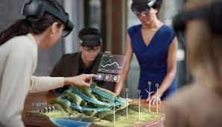

3
Meta Verse is the combination of AR, VR.
Augmented reality (AR) is an interactive experience that combines the real world with computer-generated content.
Augmented reality uses the existing real-world environment and puts virtual information .
Augmented Reality
We can experience AR with our Mobiles also. Example : Snapchat Lenses, Google AR etc.

Slide 4
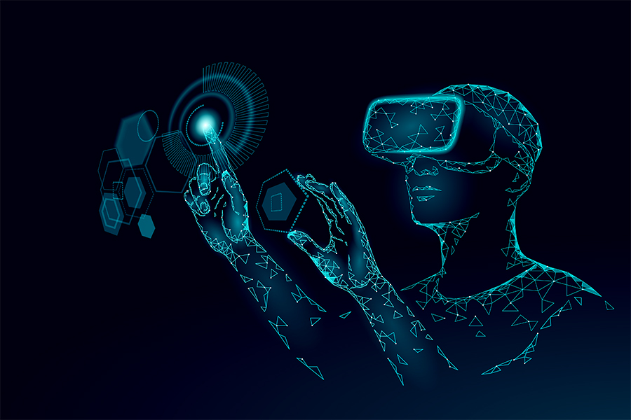
4
Meta Verse is the combination of AR, VR.
It’s a computer generated environment with scenes and objects that appears to be real, making user feel they are immersed in their surroundings.
This environment perceived through VR headsets
This perform important role in Healthcare for Training for surgeries when cadavers are not available
Virtual Reality
Real Life Example : Healthcare, Business, Real estate, Shopping, Military

Slide 5
5
How do you access metaverse :
Currently users access the digital world via screens, whether mobile or desktop devices.
Metaverse is easily accessed via hardware like headsets, gloves, watches and contact lenses.
For accessing metaverse we can use Metaverse Platforms and Apps (Ex – Facebook(now meta)).

Slide 6
6
How the metaverse will impact our lives :
Work and Collaboration:
Remote Work Evolution : The Metaverse will transform remote work by offering virtual offices, meetings, and collaborative spaces, making professional interactions more engaging.
Global Collaboration : Teams and professionals can collaborate seamlessly across borders, enhancing productivity and innovation.

Slide 7
7
How the metaverse will impact our lives :
Education and Training :
Interactive Learning: Education will move beyond traditional classrooms, offering interactive and personalized learning experiences through the Metaverse.
Skill Development: Virtual environments will be used for practical skill development and training simulations.

Slide 8
8
Current State of the Metaverse
Leading Companies and Platforms.
Facebook (Meta), Google, Microsoft, etc.
Major Applications and Use Cases
Gaming, Socializing, Education, Work, and Commerce
Challenges and Limitations
Privacy Concerns, Security Risks, and Ethical Considerations

Slide 9
9
Industry Implications
Gaming and Entertainment
Evolution of Gaming Experiences.
Virtual Concerts and Events.
Education and Remote Work
Virtual Classrooms and Virtual Offices.
Collaboration and Productivity Tools.
Healthcare
Remote Medical Consultations and Training
Therapy and Mental Health Applications

Slide 10
10
Social and Cultural Impact
Redefining Social Interaction.
Avatars, Identity, and Relationships.
Cultural Changes and Digital Citizenship.
Diversity and Inclusivity in the Metaverse.

Slide 11
11
Business opportunities in metaverse -
Higher education, medical, military and other types of trades can deliver a more immersive learning experience.
They don't need to create their own infrastructure, as the Metaverse will provide the framework.
Virtual events, having gained popularity over the last two years, can now present more integrated offerings.

Slide 12
12
Pro’s of metaverse
Traveling the world without moving.
Increasing technological literacy and skills.
Connecting with new people without feeling awkward.
Creating completely new job opportunities.

Slide 13
13
con’s of metaverse
Required of Advanced Digital Technologies.
Privacy and Security Implications.
Reducing the Difference between Real and Virtual.

Slide 14
14
conclusion
Metaverse is still in its nascent stages. It is unclear how long it will take to be fully developed or to what extent it will be able to replicate real life.
The metaverse is a virtual world that allows users to interact with each other and
engage in activities.
It's a new frontier for social interaction, education, commerce, and entertainment.

Slide 15
15
Thank
You

